Slide 1




JACKPOT
GAME
Give that jackpot a spin and land yourself a boatload of cash! 💰💰💰

Slide 2



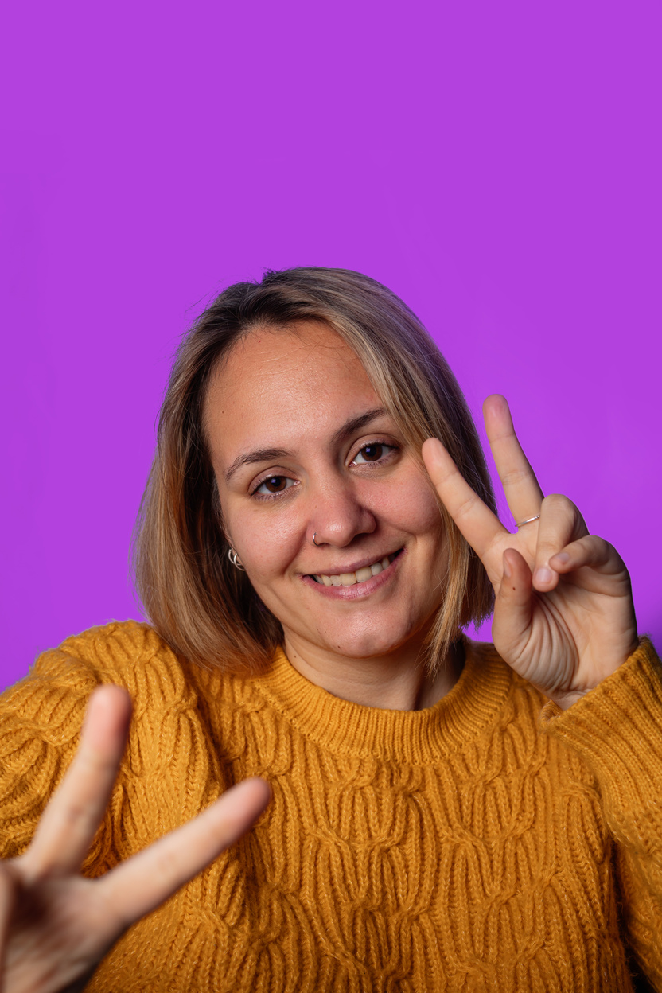


nabeel
@nebeel
get
FOZIA
registered
@fozia
and play
sofia
@sofia

Slide 3




rules
Betting amount will be doubled if all of them are same
if three of them are same or in two pair form then prize will be half of bet
if one pair same half bet will be deduct
if all of them are different then full bet

Slide 4



DEMO
TIME
jackpot

Slide 5


thank
you
for
playing

